Slide 1
Epigenomics AI Agent
A Retrieval-Augmented Generation System
By Sabij Soti

Slide 2
What is Epigenomics ?
Epigenomics is the study of heritable changes in gene expression that do not involve changes to the DNA sequence itself.
Key Mechanisms:
DNA Methylation
Histone Modifications
Chromatin Accessibility

Slide 3
Why it matters?
Development and differentiation
Aging and disease
Cancer progression and treatment
Response to environmental factors

Slide 4
Problem and Solution
Challenges
Epigenomics knowledge is scattered across thousands of research papers, datasets, and databases
Finding specific information requires extensive manual search
No single unified Q&A system exists for epigenomics
Our Solution:
An AI Agent that can:
Retrieve relevant epigenomics data using semantic search
Generate detailed, accurate answers with GPT-4o-mini
Remember past interactions
Scale with new knowledge
Goal: Build a working RAG based Q&A system for epigenomics research

Slide 5
System Architecture
User Question
↓
Semantic Search (ChromaDB)
↓
Retrieve Top 3 Most Similar Datasets
↓
Build Context from Retrieved Datasets
↓
GPT-4o-mini Generates Answer
↓
Save to Persistent Memory
↓
Display in Gradio Web UI

Slide 6
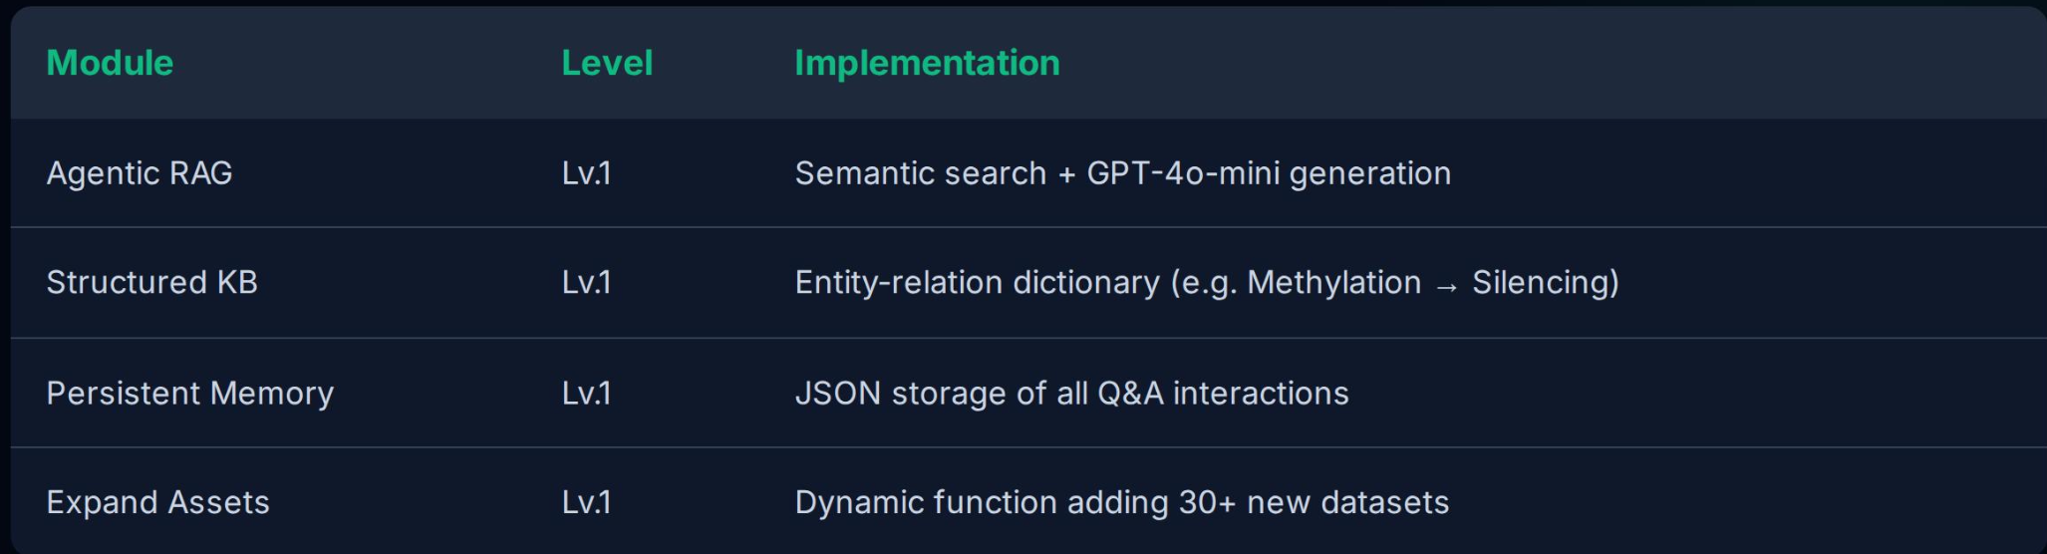
| Agent Optional Modules

Slide 7
Technology Stack
Component | Technology
Vector Database | ChromaDB
Embedding Model | Sentence Transformers (all MiniLM L6v2)
LLM | OpenAI GPT-4o-mini
Web UI | Gradio
Programming Language | Python 3.12
Memory Storage | Persistent JSON (persistent_memory.json)
Semantic Search | ChromaDB with Sentence Transformers embeddings

Slide 8
Evaluation Benchmark
24
Test question
3
Difficulty Level
6
Core Topics
Question Types
Definition, Comparison, Explanation, and Complex Listing.
Difficulty Distribution
Easy: 6 | Medium: 12 | Hard: 6

Slide 9
Knowledge Assets: 24 Epigenomics Datasets
Dataset Types:
• DNA Methylation: WGBS, RRBS
• Histone Modifications: ChIP-seq: H3K4me3,H3K27me3, H3K27ac
• Chromatin Accessibility: ATAC-seq, DNase-seq
• Cancer Epigenomics
• Technique Comparisons

Slide 10
How the Agent Works?
Input
Search
Context
Generation
Display
Memory

Slide 11
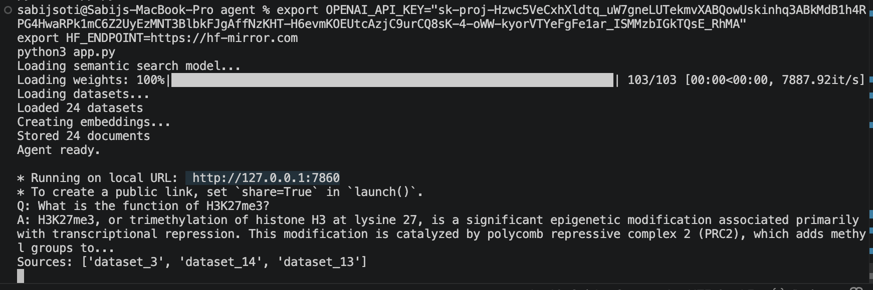
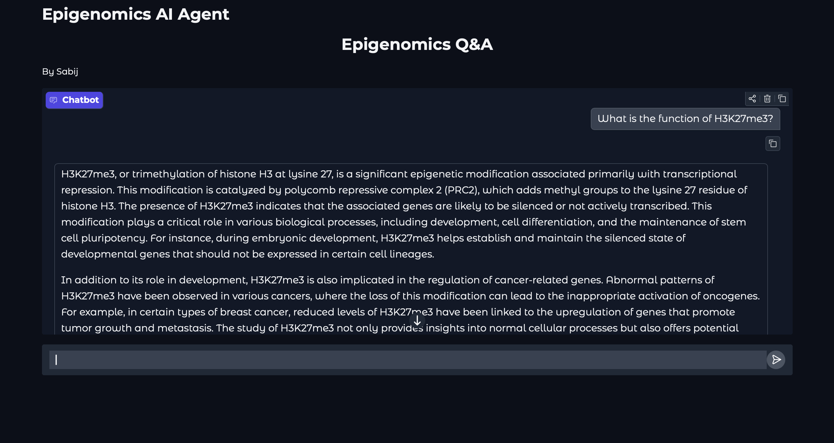
Demo

Slide 12
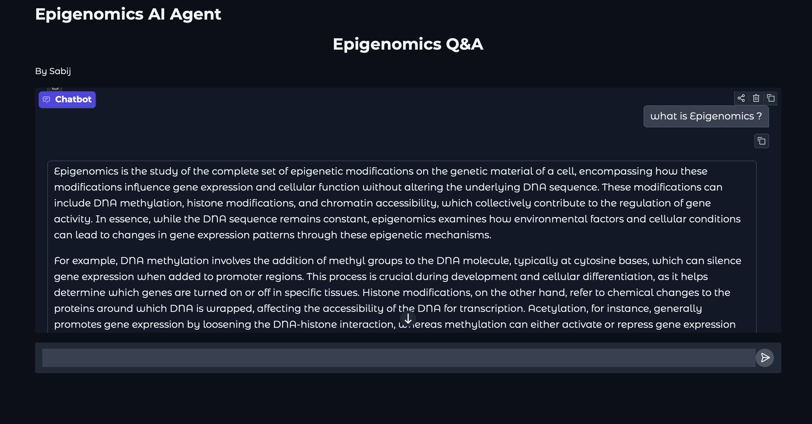

Slide 13
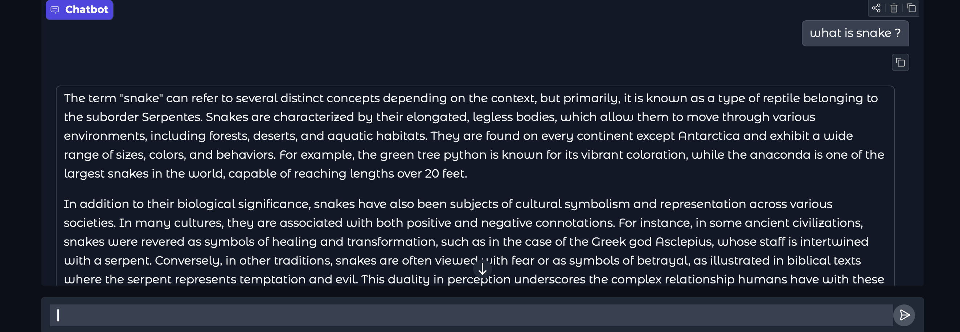
Non related question asked

Slide 14
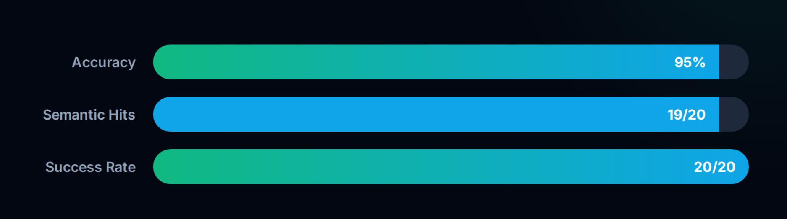
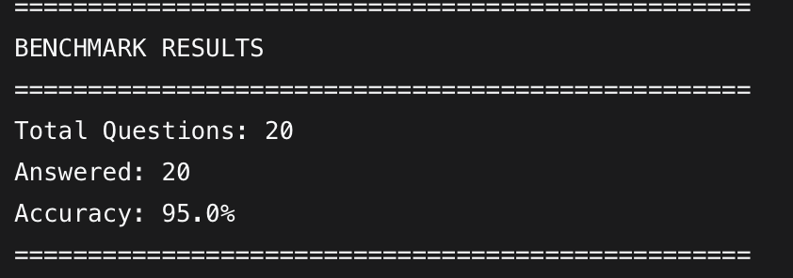

Slide 15
Conclusion
What We Built:
A fully functional RAG-based AI agent for epigenomics
Semantic search using ChromaDB
GPT-4o-mini for accurate and detailed answers
Persistent memory for cross-session recall
Clean Gradio web UI for demo

Slide 16
THANK YOU

